Slide 1
Internet of Things (IoT): An Introduction
Dr Kumar Yelamarthi
Dr Frank Walsh
Central Michigan University
Mt Pleasant, MI

Slide 2
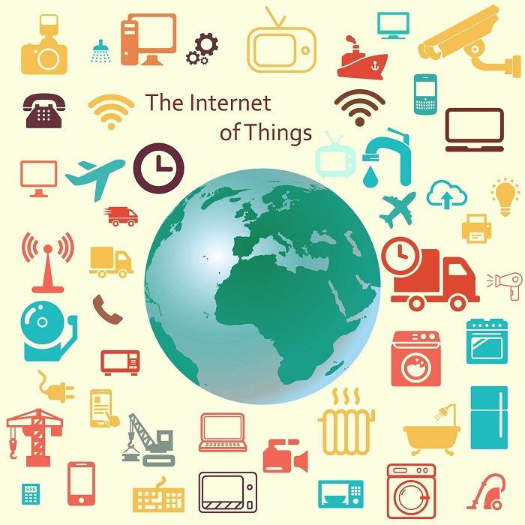
Definition
Internet → The worldwide network of interconnected computer networks, based on a standard communication protocol (TCP/IP).
Thing → An object not precisely identifiable.
Internet of Things (IoT) → A worldwide network of interconnected objects uniquely addressable, based on standard communication protocol.

Slide 3
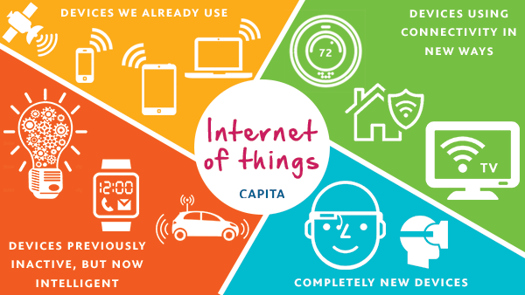
Definition (cont.,)
Extending the current Internet and providing connection, communication, and inter-networking between devices and physical objects, or "Things,".
https://www.capitatranslationinterpreting.com/the-internet-of-things/

Slide 4
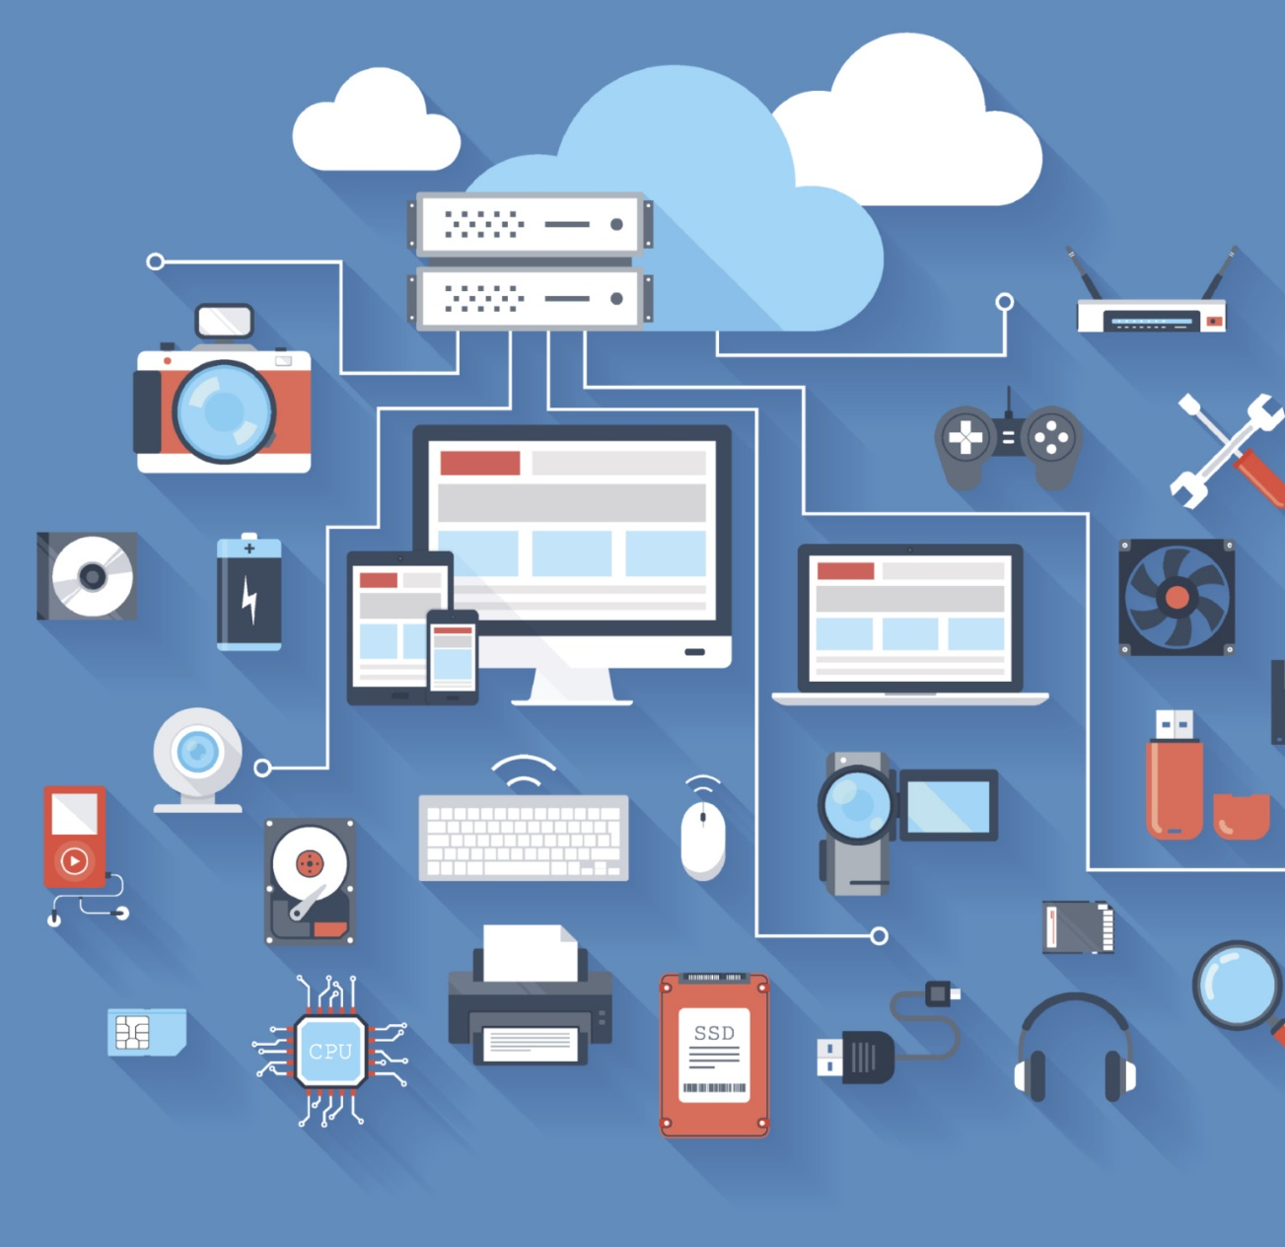
Characteristics
Everyday objects with embedded technology to sense, connect, and communicate.
Empowered by:
Sensors, cheap and accessible compute power (microcontrollers), ubiquitous connectivity, networking and internet protocols.
Transforms isolated, passive things to connected things with compute power.
Collaborate to enable ground breaking applications.
This Photo by Unknown Author is licensed under CC BY-SA-NC

Slide 5
IoT Evolution
Started with connectivity among people for sharing information.
Led to a “flat-world” where everyone across the world is connected.
Advancement in cloud computing and immersive experience led towards universal accessibility of data.
Combination of immersive experiences, connectivity and advancement in electronics further leading to Internet of Everything (IoE)
Source: Cisco
Notes:
Internet of nano things.

Slide 6
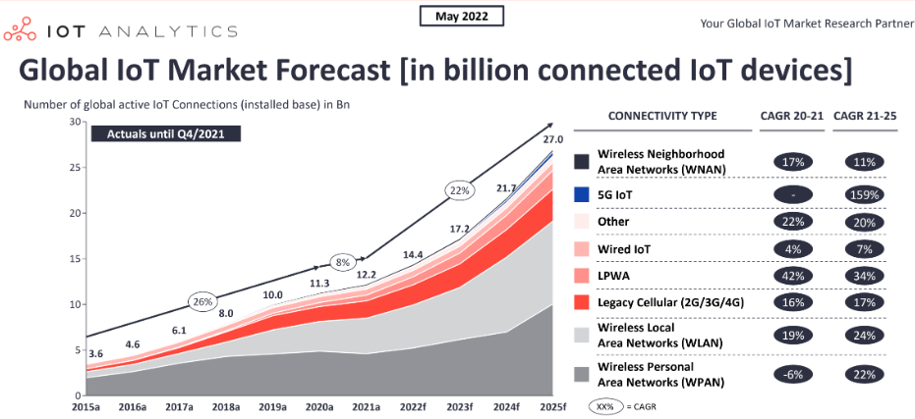
Current State of IoT
Number of connected IoT devices growing 18% to 14.4 billion globally
Even with chip shortage.
Source: https://iot-analytics.com/number-connected-iot-devices/
Notes:
The number of Internet of Things (IoT) devices worldwide is forecast to almost triple from 9.7 billion in 2020 to more than 29 billion IoT devices in 2030. In 2030, the highest number of IoT devices will be found in China with around 5 billion consumer devices. IoT devices are used in all types of industry verticals and consumer markets, with the consumer segment accounting for around 60 percent of all IoT connected devices in 2020. This share is projected to stay at this level over the next ten years. Major verticals and use cases

Slide 7
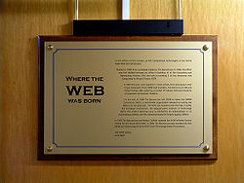
IoT Potential
First public website went live at CERN in 1990.
It took 15 years to reach 1 billion people on earth over the internet.
IoT >4 billion connected devices per year.
Economic impact
New revenue streams
Reducing costs
Reducing time to market
Improving supply chain
Reducing production loss
Increasing productivity
This Photo by Unknown Author is licensed under CC BY-SA

Slide 8
IoT Enablers
Humans
They can act both as consumers and producers of data
Smart devices
Technological advances and reduction in the cost of manufacturing has enabled widespread adoption of smart devices
Communication Networks
Diverse method such as Wi-Fi, Bluetooth LE, Zigbee, ANT+, GPRS, 3G are the key denominator as they make a lot more options available to the IoT
Cloud Computing
Scaling rapidly to meet the growing demand resulting from the IoT in terms of storage and computational power

Slide 9
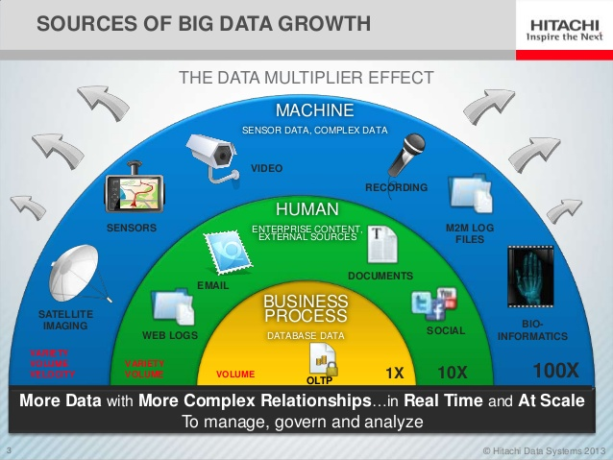
Big Data - Enablers
1.7MB of data was created every second by every person during 2020.
90% of the world’s data has been created in last 2 year (https://techjury.net/blog/how-much-data-is-created-every-day/)
Sources
Physical Environment
Smartphones & wearables
Online presence
Notes:
90% of world’s data created in last 2 years
By 2020, 40% of data will come from sensors
Walmart collects 2.5 petabytes of data hourly from customer transactions
Singapore generates several Terabytes of data every day

Slide 10
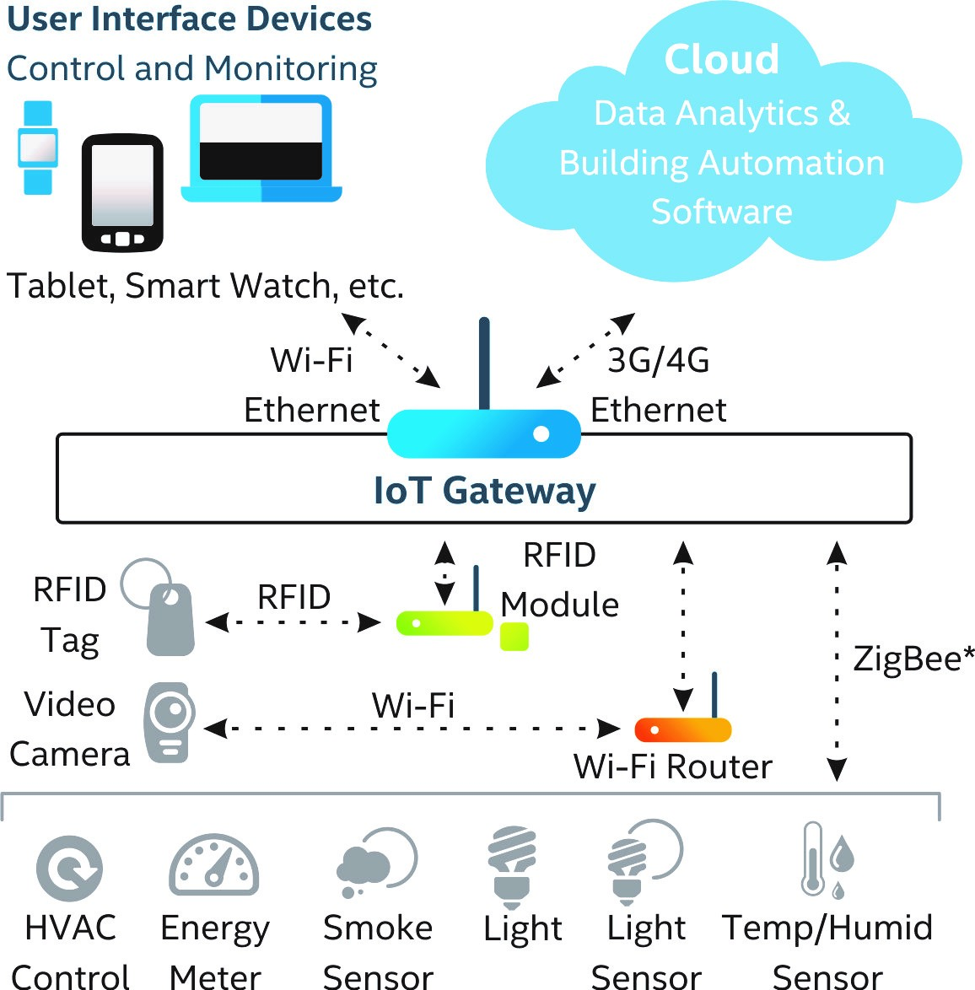
Building Blocks of an IoT System
Sensing
Connectivity
Gateways
Processing
Software
Power

Slide 11
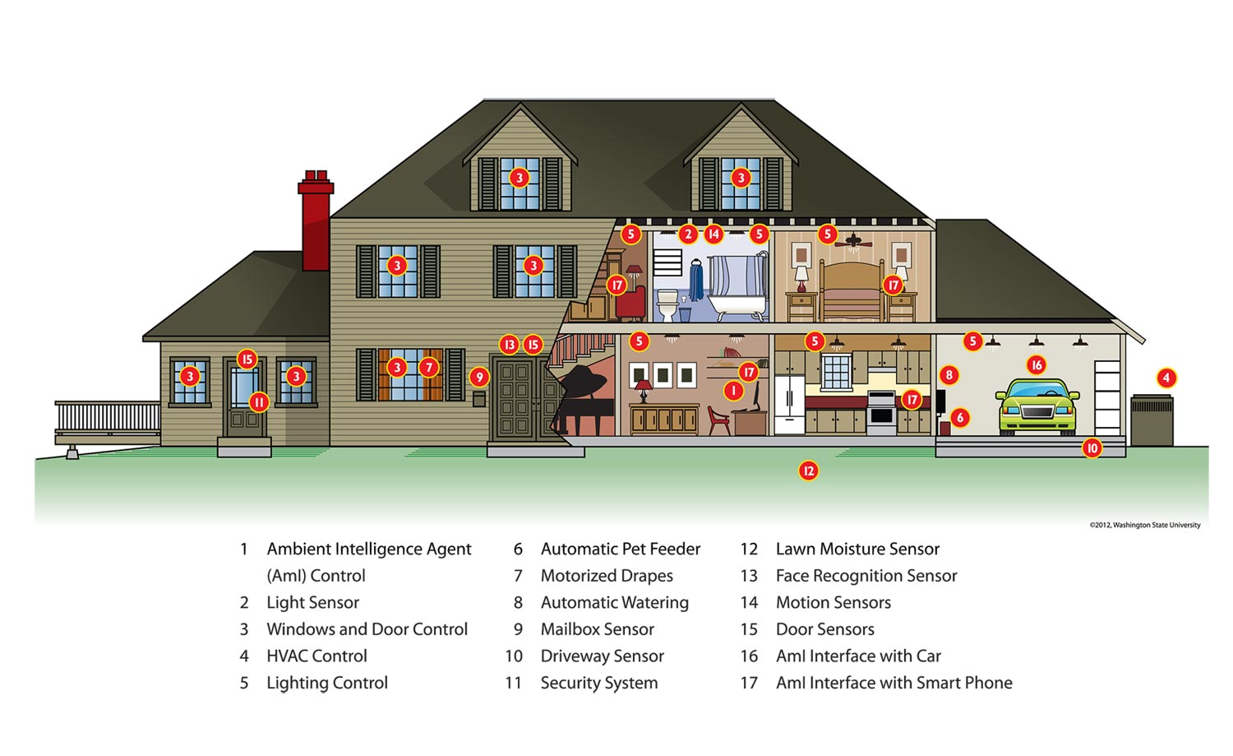
Sensors – Healthy Independent Living
They are mainly input components
They sense and collect surrounding information
Basically, three types:
Passive, omnidirectional (e.g. mic)
Passive, narrow-beam sensor (e.g. PIR)
Active sensors (e.g. sonar, radar, etc.)
http://www.nibib.nih.gov/sites/default/files/SMART-HOUSE_2_DCook.jpg
Notes:
Passive infra red

Slide 12
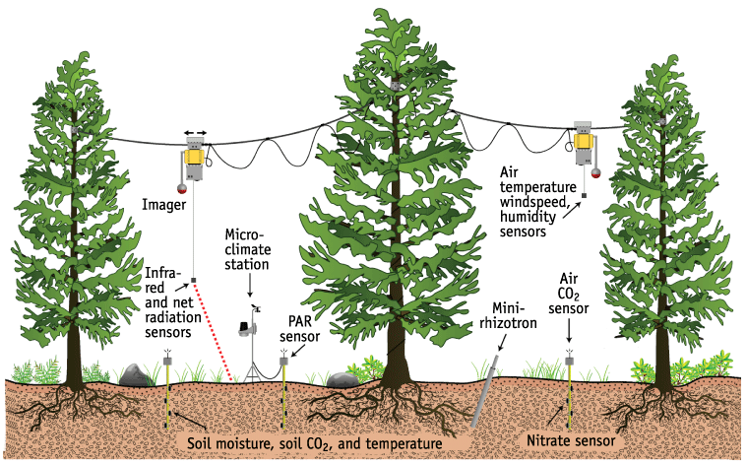
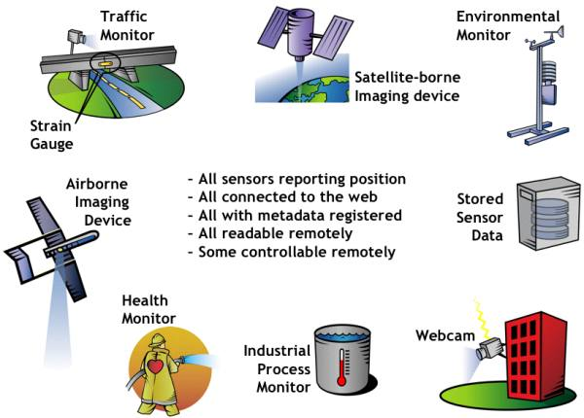
Sensors – Environmental Monitoring
http://www.environment.ucla.edu/media/images/Fig1_NIMS-lrg.gif
http://www.opengeospatial.org/pub/www/files/images/SWE%20Overview_0.jpg

Slide 13
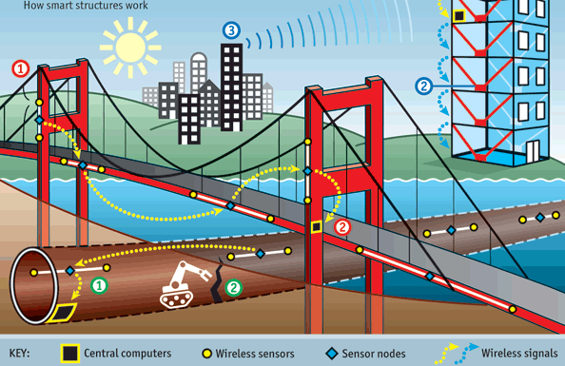
Sensors – Infrastructure Health Monitoring
Smart Building
Sensor to detect strong wind or earthquake
Shock absorbers can react to minimize the damage
Building could warm other building to prepare for the event
Smart Bridge
Sensors to monitor vibrations, displacement, and temperature
If problem is detected, a warming can be sent by SMS
Smart Tunnel
Sensors to monitor humidity, displacement, and temperature
If problem is detected, appropriate maintenance can be carried out
www.rfwirelesssensors.com/2010/12/energy-harvesting-wireless-sensor-networks-for-smart-structures

Slide 14
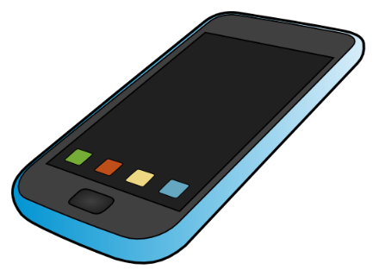
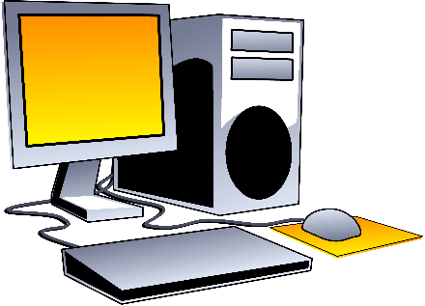

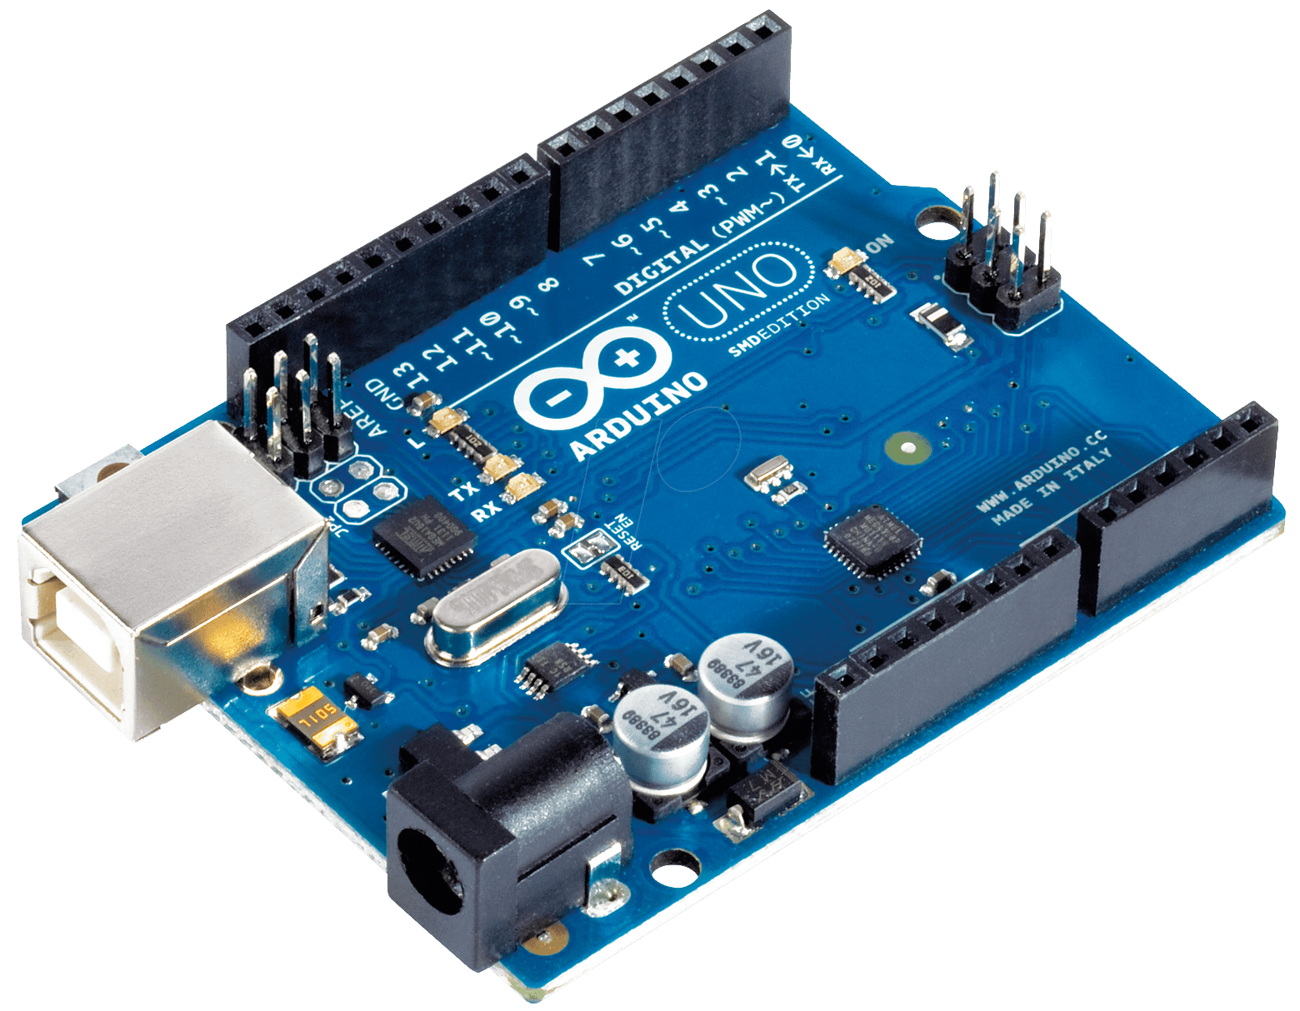
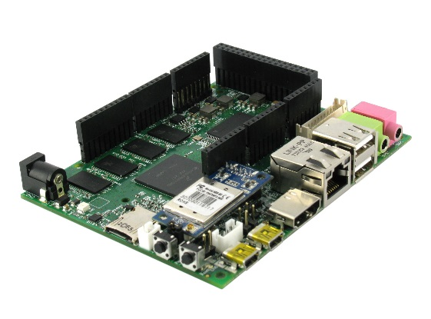
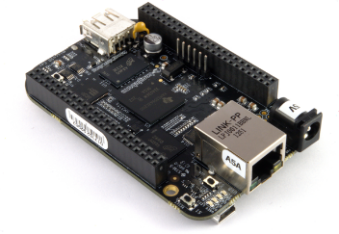
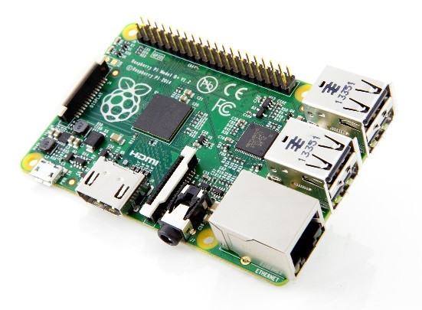
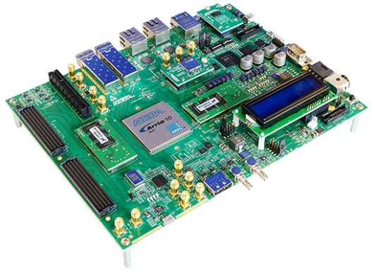
Embedded Processing Units
Create cohesion between the physical and the technological realms.
Used either to allow objects sense their surroundings, or exchange data with other systems, or interact with the cloud, they are integral in an IoT system.
Given the changing nature of the landscape, microprocessors that are low power, cost-effective and leave a smaller imprint will be those that are favoured within the IoT.

Slide 15
Embedded Processing Units
Selection Criteria
Physical size
Power management
Interface requirements
Performance requirements
Security needs
Safety and fault tolerance
Debugging capabilities
Cost
Architecture (x86, ARM, etc.,)
Feedback required

Slide 16





Communication Medium
The Role of Communications
Providing a data link between two nodes
Communication type:
Wireline (e.g. copper wires, optical fibers)
Wireless (e.g. RF, IR). RF-based communication is the most popular choice
Popular RF-based communication solutions:
IEEE 802.11 (or Wi-Fi)
Bluetooth
Near Field Communication (NFC), e.g. RFID
Low Power Wide Area Networks (Sigfox)

Slide 17
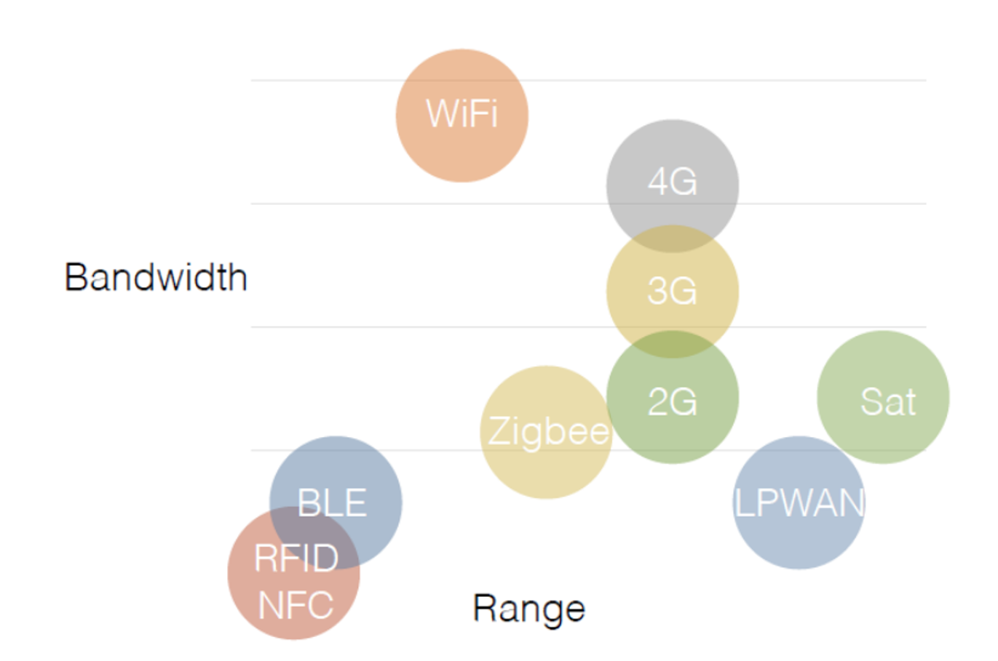
Communications - Wireless Landscape
Each protocol is targeted at different types of applications.
In addition to these protocols, there are also a number of different license-free frequencies, such as 900 MHz, 2.4 GHz and 5.8 Ghz, used as the carriers for these signals.
Each frequency has its advantages and challenges regarding distance and bandwidth

Slide 18
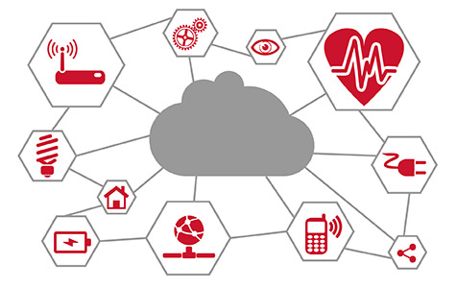
Networks
The Roles of Networks
Managing nodes (discovery, join, leave, etc).
Relaying data packets from the source to the destination node in the network.
Networks are a distributed system. All nodes need to perform networking related tasks.
RF-based Network in IoT is usually a Wireless Multi-hop Network.
Wireless Sensor Networks (WSNs)
Mobile Wireless Ad hoc Networks (MANETs)
Wireless Mesh Networks (WMNs)
Vehicular Ad Hoc Networks (VANETs)
Main concern: Reliability & Performance
http://www.psemi.com/markets/industrial/internet-of-things

Slide 19
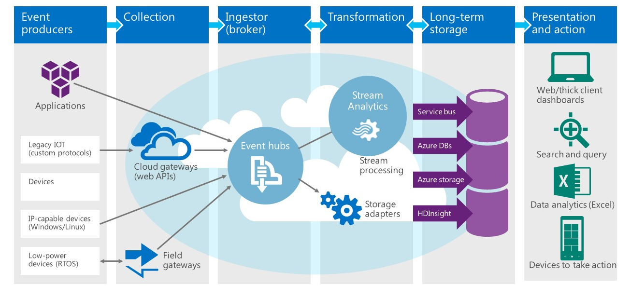
Microsoft Azure – IoT Sensor Data Platform
https://dzone.com/articles/pushing-realtime-sensors-data-into-asa-visualize-i

Slide 20
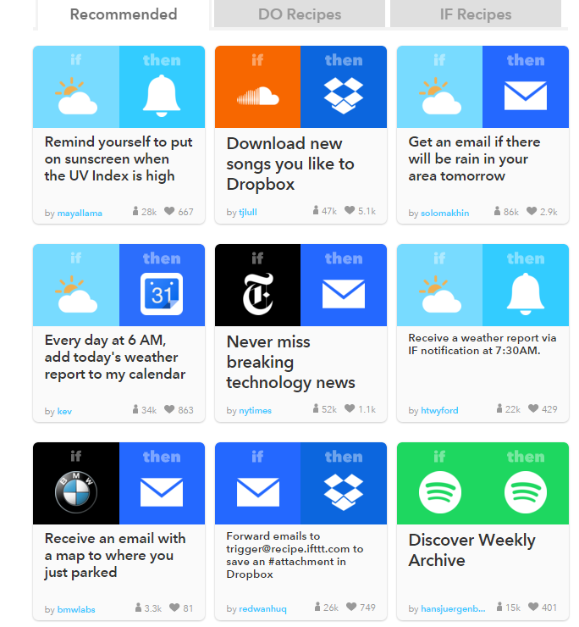
Services - IoT
Web-based service that allows users to create chains of simple conditional statements.
Example
Sending an email if a condition evaluates to true
Tweet using a certain hashtag
Can integrate with diverse services
Blogging – Blogger, Tumblr, Weebly
Business – LinkedIn, Square, Stocks
Commerce – Craigslist, Home Depot
Connected Home – D-Link, Amazon Alexa, Nest Thermostat, Wemo devices (coffeemaker, heater, humidifier,)
Mobile – Android Phone call, photos, SMS
Productivity – Google Drive, Dropbox, OneNote, Evernote
Easy to integrate with hardware devices
https://ifttt.com/recipes

Slide 21
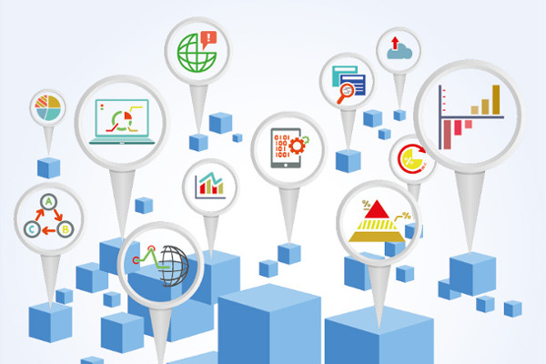
IoT Challenges
Data privacy, governance, and compliance issues
Data complexity
Integrating legacy system with big data technology
Lack of skills (internally, or ability to hire)
The cost of big data tools
https://jaxenter.com/actian-112215.html
Notes:
http://iotworm.com/biggest-challenges-for-the-internet-of-things/
https://www.bosch-si.com/lp/iot-big-data.html?tab=2
https://jaxenter.com/actian-112215.html

Slide 22
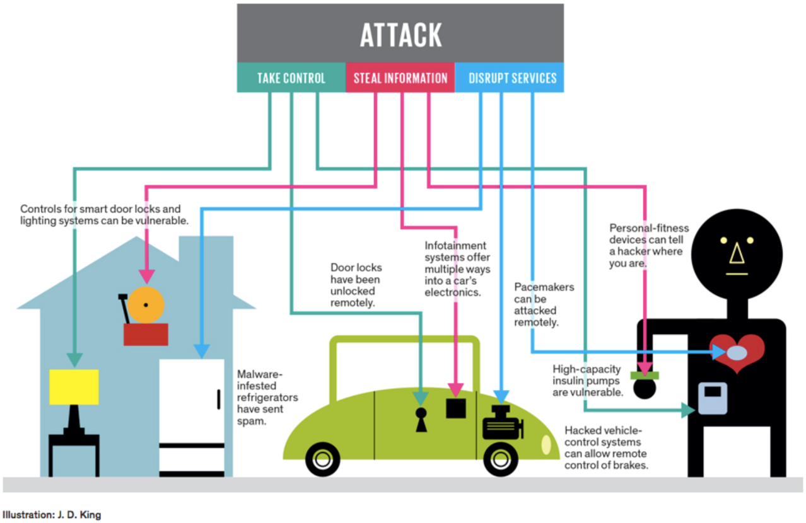
IoT Challenges - Security
Usable Security
How do we make security solutions usable, scalable, manageable and non-intrusive?
Privacy
How we do we make users feel comfortable using network services?
Infrastructure & Service Protection
Technical security solutions for the networked society’s “threat landscape”
www.pubnub.com/blog/2015-05-04-10-challenges-securing-iot-communications-iot-security/

Slide 23
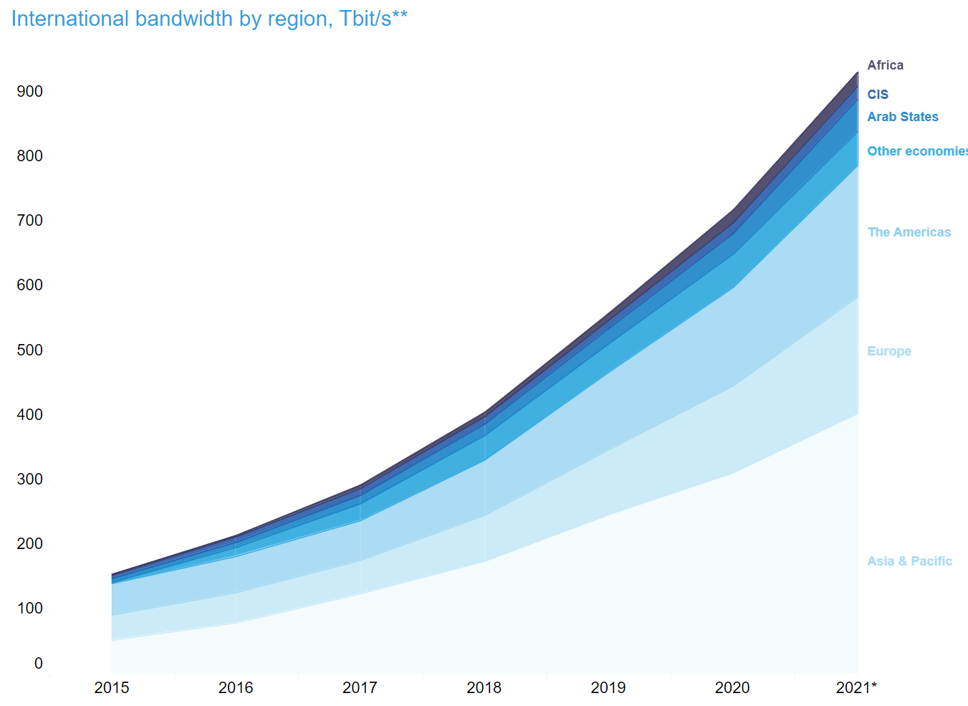

IoT Challenges – Bandwidth & Power Consumption
International bandwidth availability has soared
From 1.4 Tbps in 2002, it steadily climbed to 6.7 Tbps in 2006
TeleGeography expects that number hit approx. 900 Tbps in 2021.
Notes:
https://s-media-cache-ak0.pinimg.com/736x/eb/40/75/eb407570898b1a26b31f0a7cebf75b62.jpg
http://cdn.arstechnica.net/2012/04/27/used_intl_bw_for_ars_technica-4f9a9cf-intro.png

Slide 24
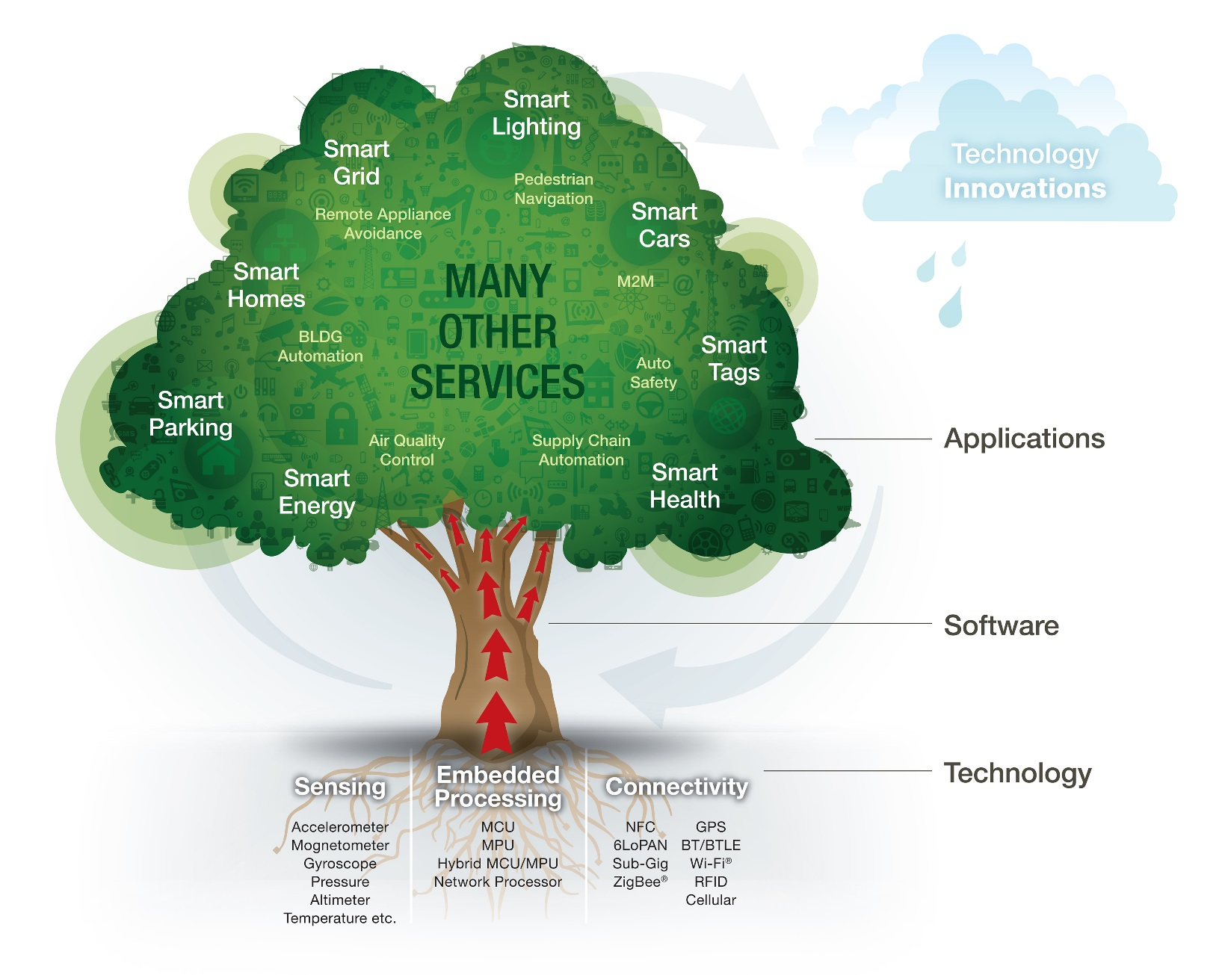
IoT - Opportunities

Slide 25
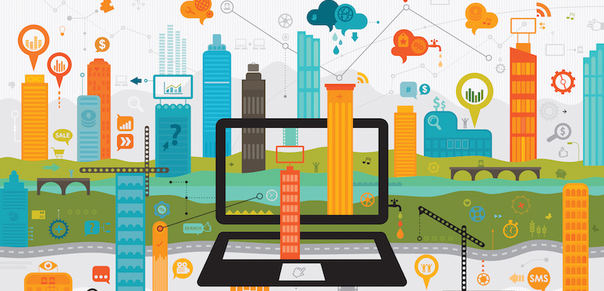
IoT Applications - Infrastructure
Improving infrastructure
Creating more efficient and cost effective municipal services
Enhancing public transportation
Reducing traffic congestion
Keeping citizens safe and more engaged in the community.
Notes:
http://evonexus.org/events/entrepreneurial-opportunities-in-iot/

Slide 26
IoT Applications – Connected Vehicles
Source: Connected Vehicles: Solutions and Challenges

Slide 27
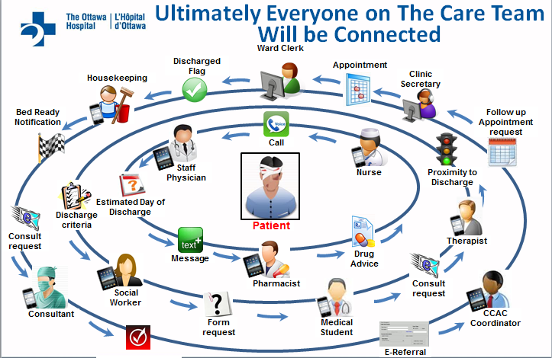
IoT Applications - Healthcare
Patient monitoring and diagnostics
Information and data transfer, storage, and collaboration
Intelligent healthcare devices and tools (smart wheelchair, RFID, sensors)
Connected emergency units, response vehicles, and hospitals
Notes:
https://www.pubnub.com/blog/2015-06-19-realtime-technology-and-the-healthcare-internet-of-things/

